Slide 1
Best Places for Finding a Job: The Role of Regional Occupational Structure in Residents’ Employment Prospects
China Layne, Ph.D.
Summit Consulting, LLC
May 30, 2015

Slide 2
Introduction

Slide 3
Research Questions
How much does a person’s employment prospects depend on the local area in which they live?
Does a local area’s occupational structure affect its residents’ employment prospects beyond the effect of their own human capital?
Do differences in occupational structure of local areas help explain some of the variation in residents’ employment prospects across these areas?

Slide 4
Data and Analysis Sample
The analysis uses the American Community Survey (ACS) 2011, 1-year Public Use Micro Sample (PUMS) file.
A nationally representative survey of 3 million household addresses each year
Collects information on the demographics, housing, and social and economic characteristics of respondents
The universe for the analysis includes:
Residents aged 16 years or older,
In the civilian labor force at the time of the interview,
In each of the 2,057 local areas in the United States.
Local Areas in the analysis: Public Use Micro Areas (PUMA) are contiguous geographies of at least 100,000 people that do not cross state boundaries.

Slide 5
Defining the Local Area Occupational Structure
We conceptualize the local area’s occupational structure in two ways.
Primary Occupation Concentration: the occupation group in which the local area is most specialized, and
Occupation Diversity: how many different occupation groups in which the local area is specialized.
Both aspects of occupation composition are measured using location quotients.
Location quotients compare the share of a local area’s workforce employed in a specific occupation group to the share of the nation’s workforce in this same occupation group.
Location Quotient_{OL} = (E_{OL} / E_{TL}) / (E_{ON} / E_{TN})
Where: E = Employed, and subscripts O = Occupation, L = Local Area, T = Total Workforce, and N = Nation.
A location quotient equal to or greater than 1.25 denotes an occupation concentration that is at least moderately strong.

Slide 6
Occupational Classification
In this research, we group the occupations into eight categories, similar to each other in type of work and earnings.

Slide 7
Analysis Method
To model a person’s likelihood of being employed, we use a two two-level, logistic, random-intercept model where:
X,xxx,xxx residents are nested within the 2,057 local areas, and
a person’s likelihood of being employed is allowed to vary randomly across local areas.
We quantify the amount by which a person’s likelihood of being employed is influenced by the local area in which they live.
We separately model the effects on a person’s likelihood of being employed of
Personal characteristics, specifically educational attainment and
Local area characteristics, specifically occupational structure

Slide 8
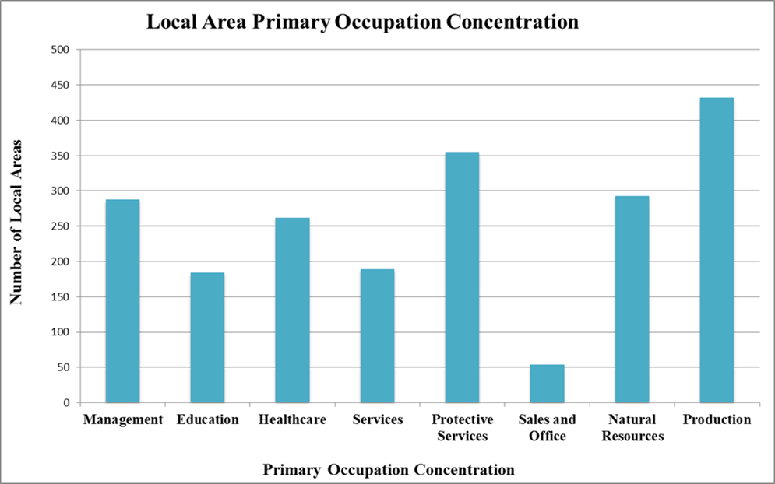
Local Area Occupational Structure: Primary Occupational Concentration
A local area’s primary occupation concentration is the occupation group with the largest Location Quotient value.
Most local areas’ primary occupation concentration is in Production, Protective Services, or Natural Resources.

Slide 9
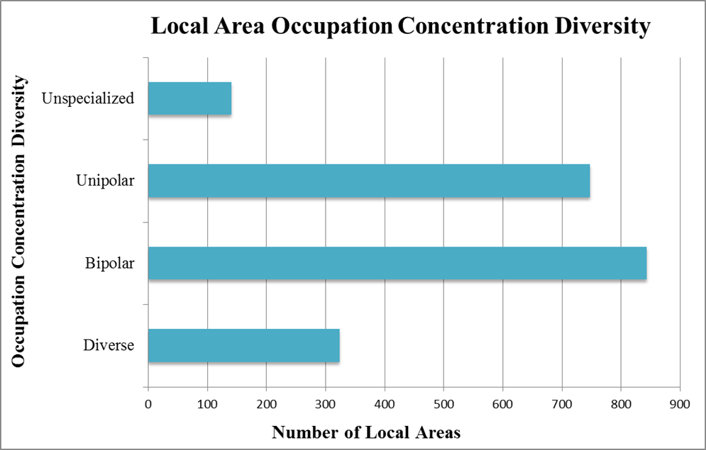
Local Area Occupational Structure: Occupational Diversity
We measure a local area’s occupation diversity in four categories:
Unspecialized - No occupation concentrations,
Unipolar – One occupation concentration,
Bipolar – Two occupation concentrations, and
Diverse – Three or more occupation concentrations
Most local areas have bipolar or unipolar occupation diversity.

Slide 10
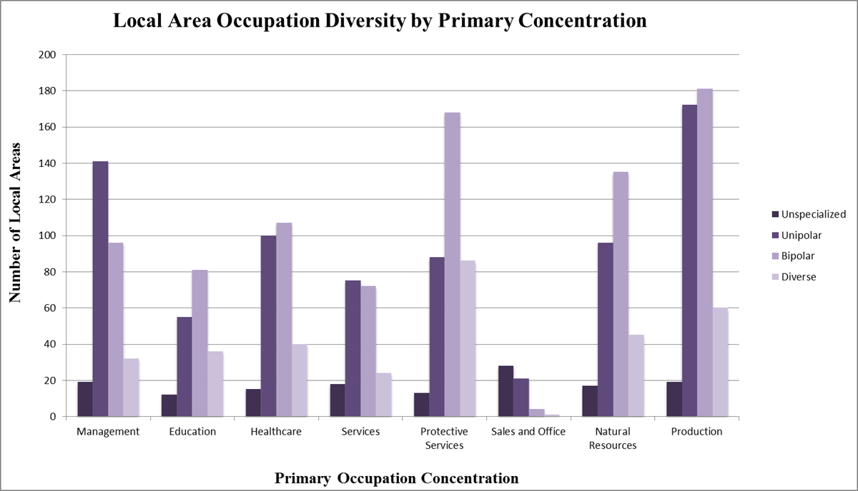
Local Area Occupational Structure: Primary Concentration and Diversity
Most local areas with a primary concentration in production have only one or two occupation specializations.
Nearly half of local areas with a concentration in management have only one occupation specialization.

Slide 11
Model Results: Personal Characteristics

Slide 12
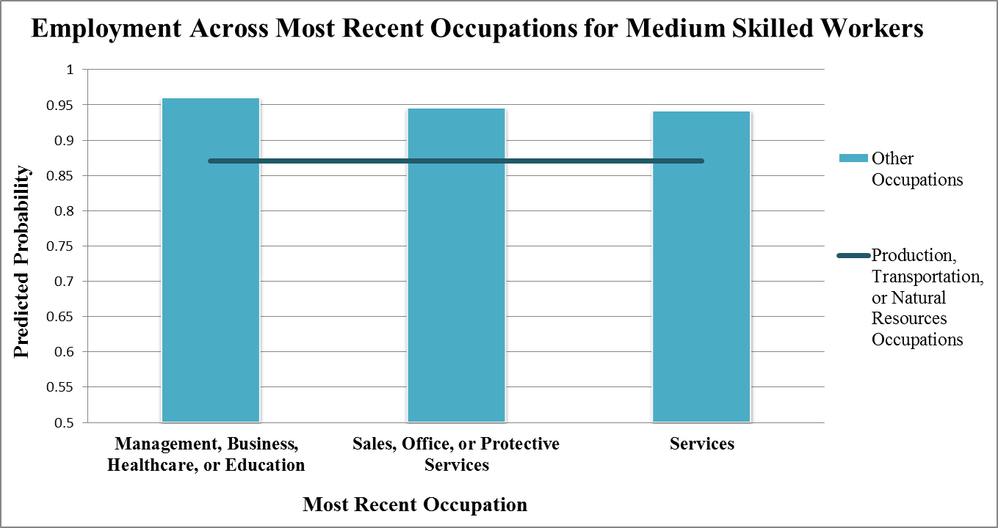
Model Results: Most Recent Occupation and Education
Medium skilled residents whose most recent occupation was management
or services are more likely to be employed than production workers.

Slide 13
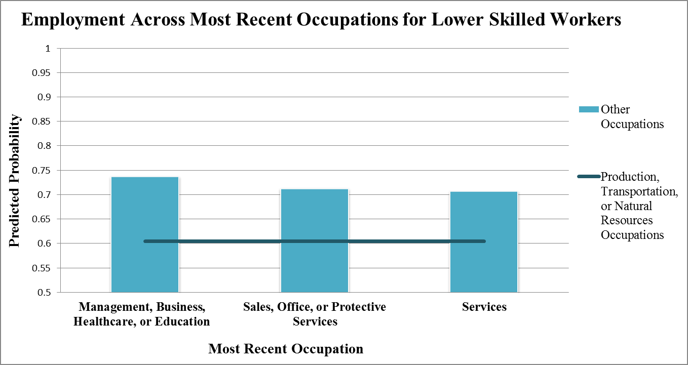
Model Results: Most Recent Occupation and Education
Lower skilled residents whose most recent occupation was management
or services are more likely to be employed than production workers.

Slide 14
Model Results: Local Area Characteristics

Slide 15
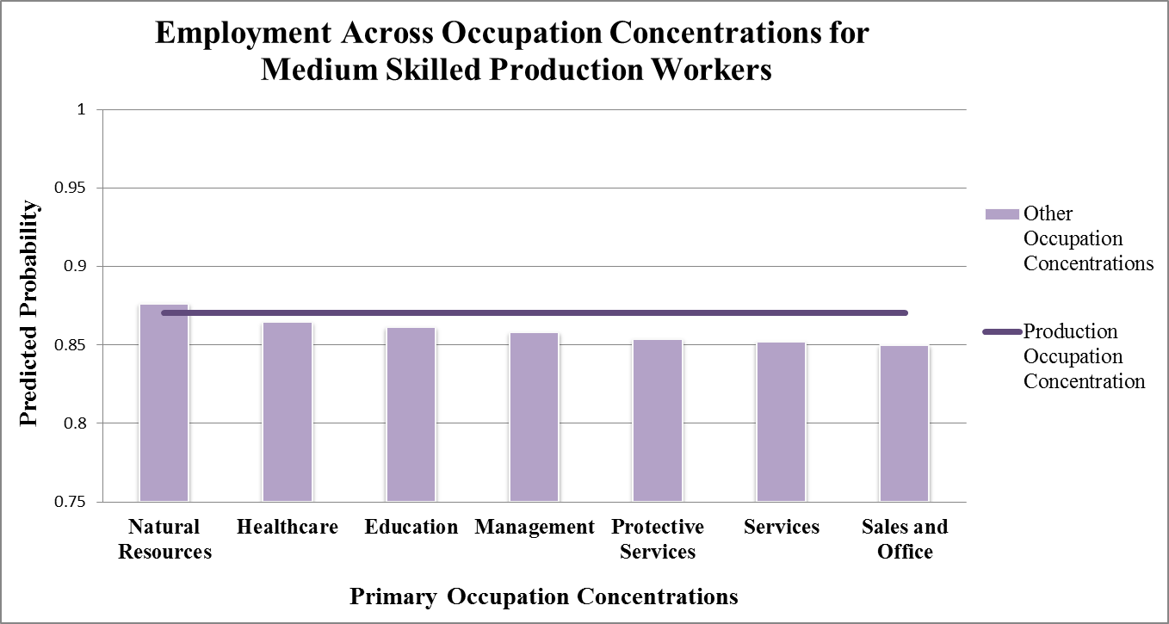
Model Results: Occupation Concentration, Occupation, and Education
Medium skilled production workers living in local areas that specialize in
natural resources are more likely to be employed.

Slide 16
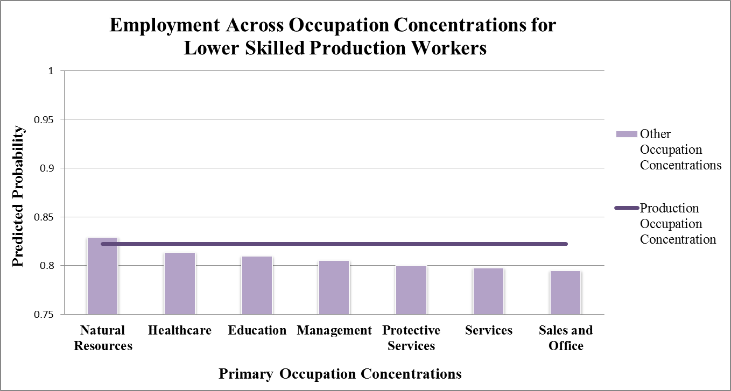
Model Results: Occupation Concentration, Occupation, and Education
Lower skilled production workers who live in local areas that specialize in
natural resources are more likely to be employed.

Slide 17
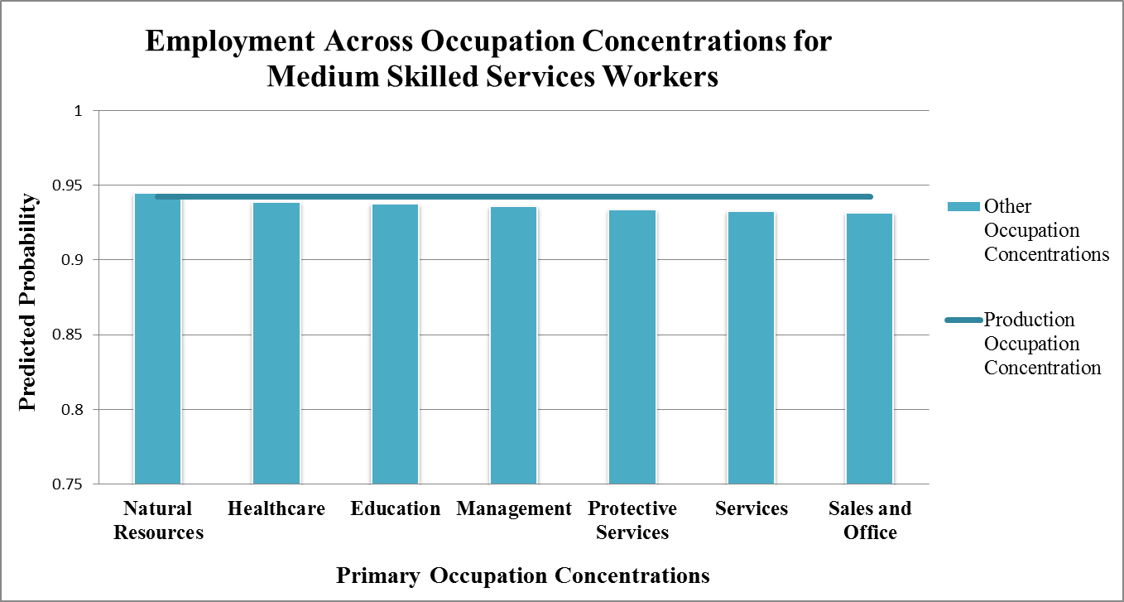
Model Results: Occupation Concentration, Occupation, and Education

Slide 18
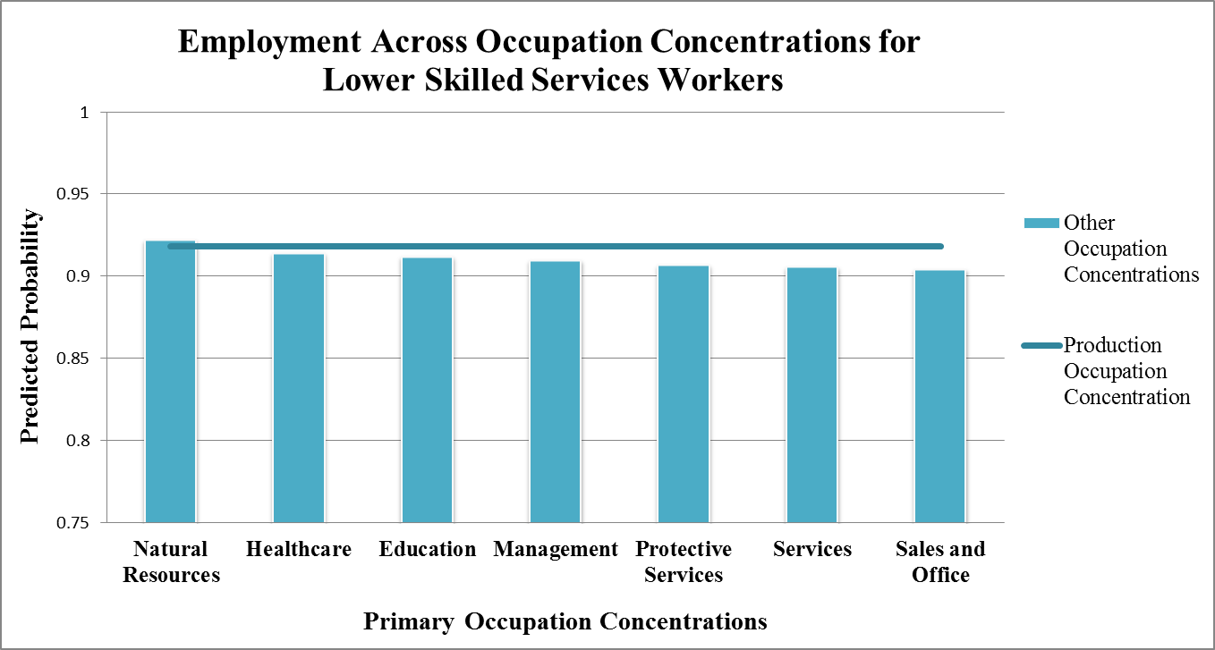
Model Results: Occupation Concentration, Occupation, and Education

Slide 19
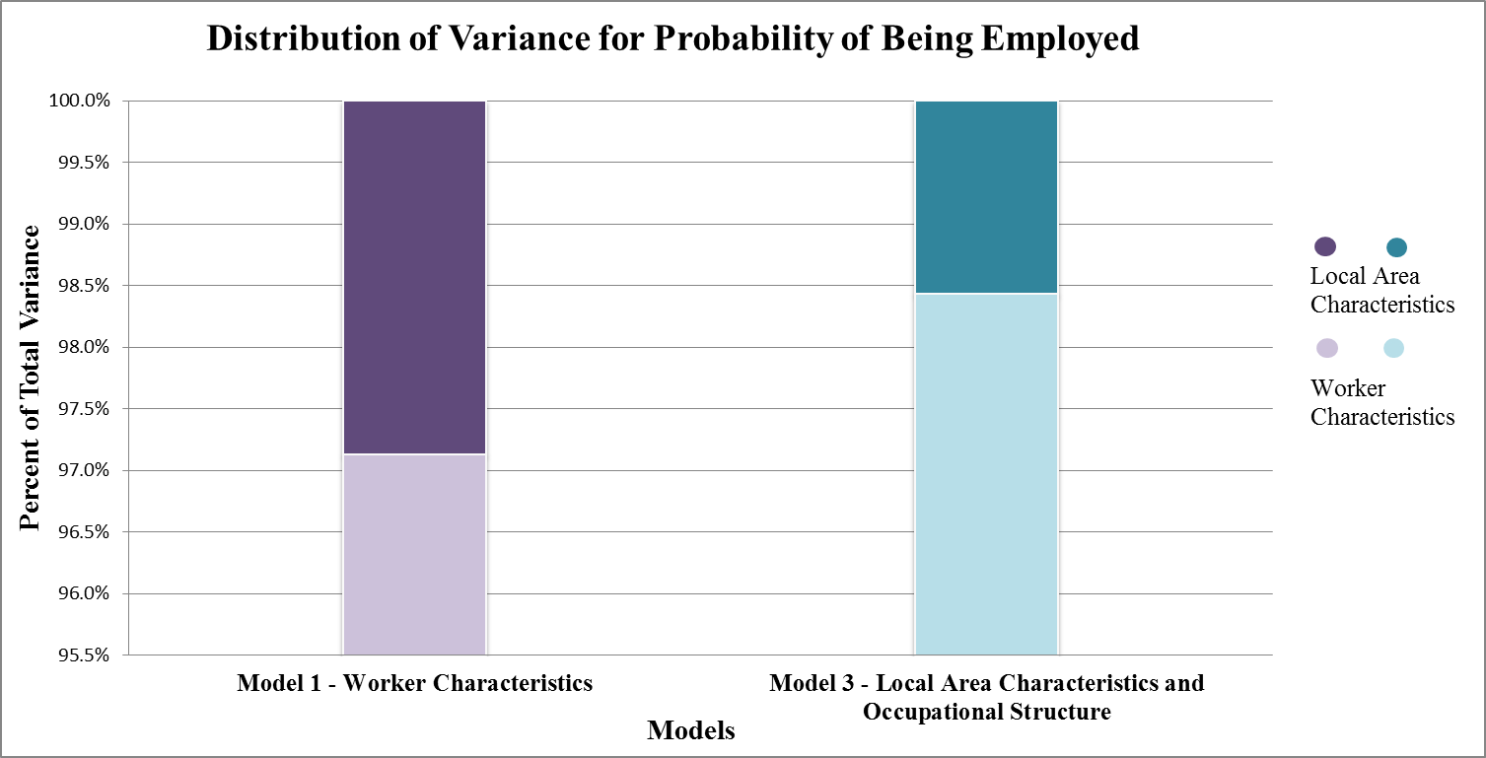
Model Results: Explaining Variance Across Regions
About 3% of a person’s total probability of being employed is related to local area
characteristics rather than personal characteristics

